Slide 1

Simple notification service

Slide 2
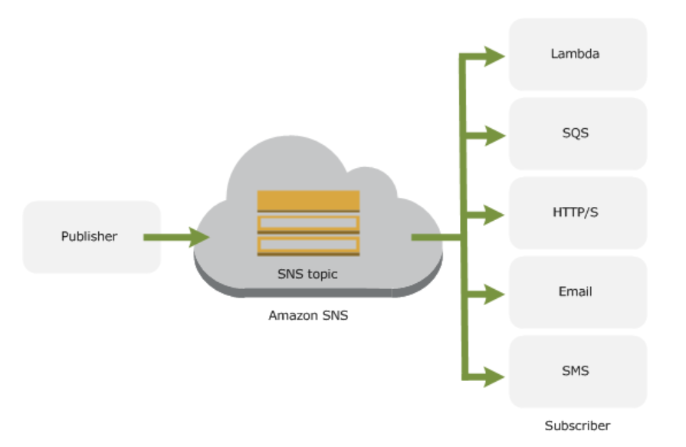
Concept of SNS
Solutions
Same message can be sent to different consumers
Consumers are selected based on topic
Consumers like the email, lambda, sqs etc. can be selected.

Slide 3
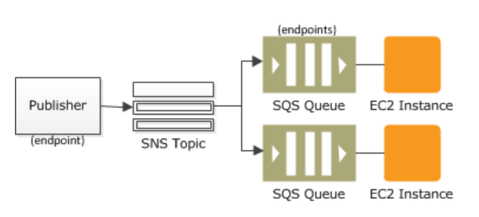
fanouts
Solutions
Send messages to multiple end points parallelly
Send notification of received order to different systems parallelly
Send debug and error messages.
Send mobile push notifications
Trigger lambda code
Send email and SMS notifications.
Messages are durable and stored in many availability zones.

Slide 4
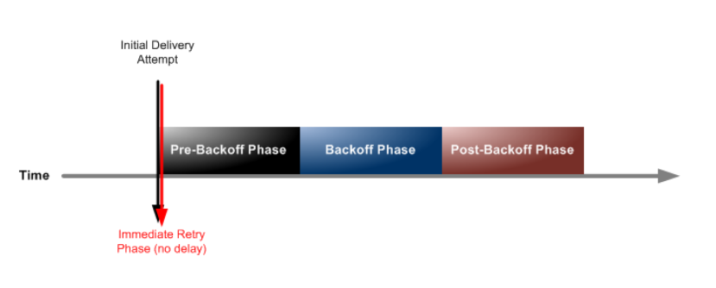
Sns delivery delays

Slide 5
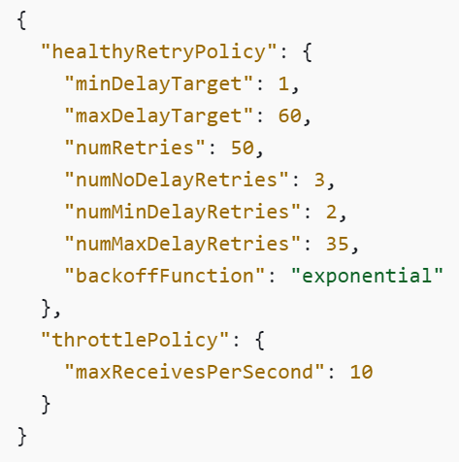
Sns delivery delays
The following JSON object represents a delivery policy that instructs Amazon SNS to retry a failed HTTP/S delivery attempt, as follows:
3 times immediately in the no-delay phase
2 times (1 second apart) in the pre-backoff phase
10 times (with exponential backoff from 1 second to 60 seconds)
35 times (60 seconds apart)

Slide 6
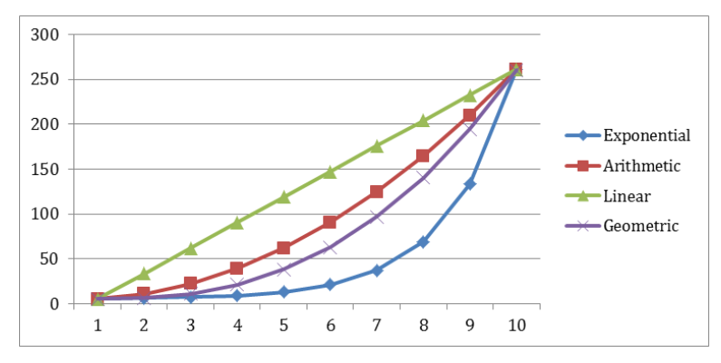
Delay functions

Slide 7
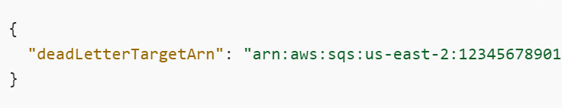
Dead letter queue
We need to debug issues:
Send messages but not process
Handle situations where the data sent to the consumer is more than the maxRequest count
Created by specifying a redrive and a deadLetterTargetARN
You can get notified using email or message using a dead letter threshold setups

Slide 8
Message metadata
Message attributes:
Additional information
Upto 10 attributes are possible
Message attribute components
Name
Type
Value

Slide 9
Message filtering
Control which messages can be read by subscribers:
Use a JSON filtering conditions
If not given all messages are read
Eg. Read ORDER_PLACED, ORDER_FULFILLED status in different subscriptions
Use message headers for this purpose

Slide 10
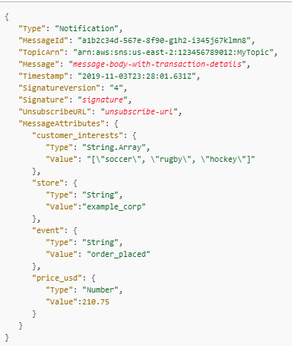
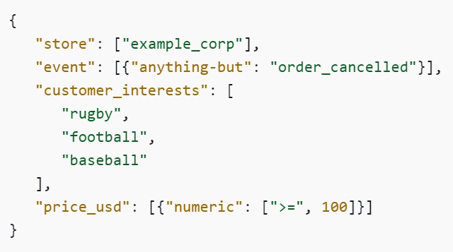
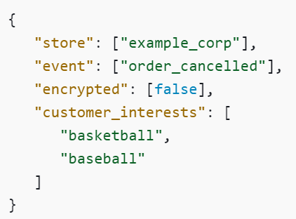
Message filtering
policy
Policy that accepts message:
Policy that rejects message:

